Slide 1
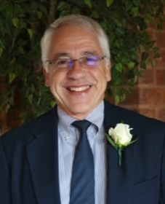
OPTIMIST BRAIN BOWL
2021
Gunar Neumann, DTC OC
Brain Bowl Trainer
Updated 12 OCT 2020

Slide 2
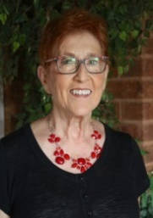
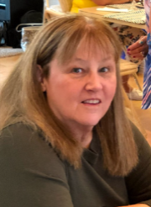
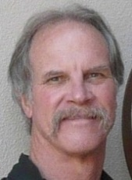
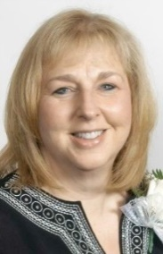
2021 OPTIMIST BRAIN BOWL
Academic team competition for 6th, 7th and 8th grade students in CO & WY
Volunteer Chair:
Nancy DeNiro
Co-Chairs:
Connie Ackerman
Rich Urbanowski
Sharon Foster

Slide 3
2021 vs 2020
One Virtual Contest vs Four In-person Contests
No Written Round in 2021
No Buzzers in 2021
Virtual Training vs In-person Training
2021 Contest Rules under development

Slide 4
2021 TOURNAMENT
Virtual Contest
30 JAN 2021, Saturday
On-Line Platform
2021 VOLUNTEER TRAINING
Virtual Training
Date(s) TBD
On-Line Platform
Details to be posted to Brain Bowl Website

Slide 5
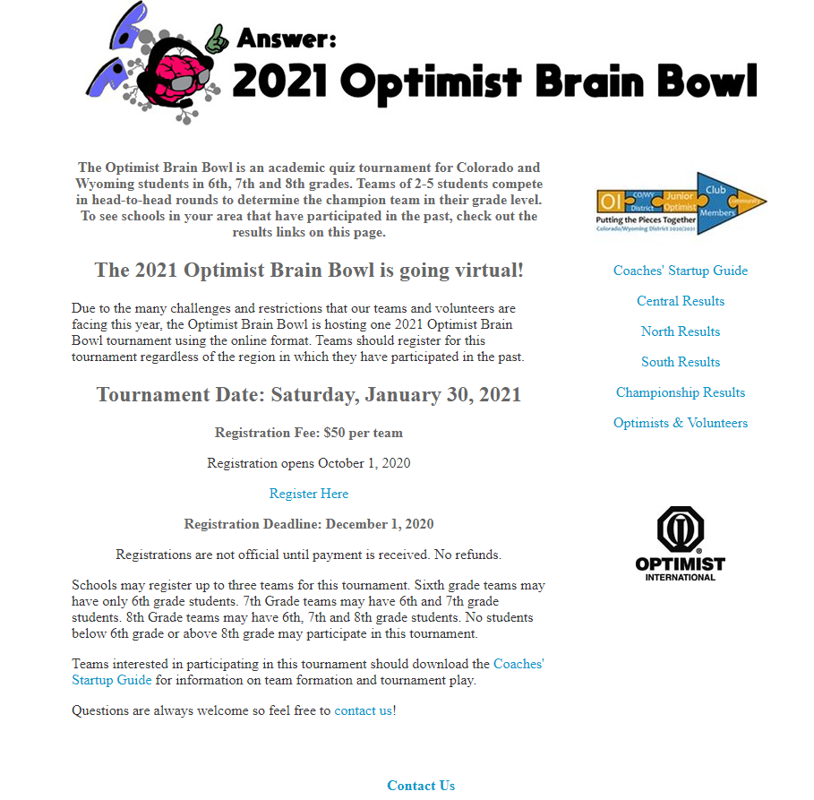
2021 Brain Bowl Website
https://www.optimistbrainbowl.org

Slide 6
2021 OPTIMIST BRAIN BOWL
Optimist Club Support
Send checks made payable to Optimist Brain Bowl to:
Chris Wienecke
8015 Melrose Drive
Wheat Ridge, CO 80033
Questions?
Contact any Brain Bowl Chair

